Slide 1
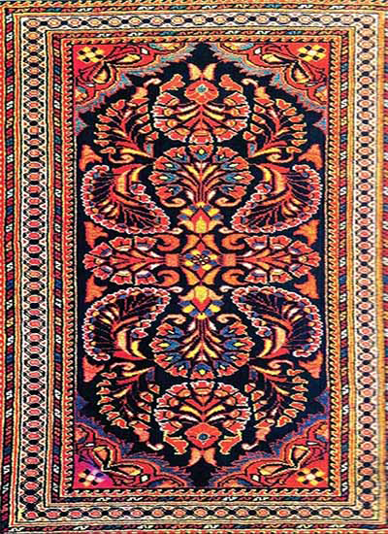
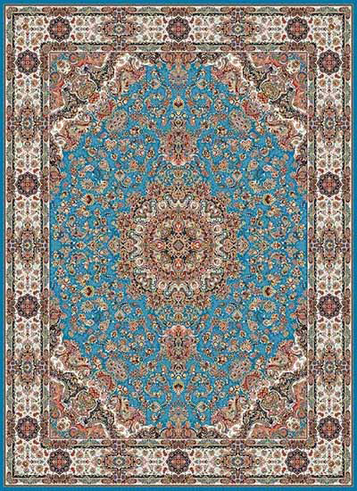
Project: Carpet Shop
Hand production
Mashine production

Slide 2
Languages and libraries:
HTML, CSS, HTML5: forms validation
PHP :
- work with functions ,
- readind&writing XML files,
- global variables ($_SESSION, $_POST, $_GET,$_REQUESS),
- PHP function, classes and objects
JavaScript: forms validation
MySQL

Slide 3
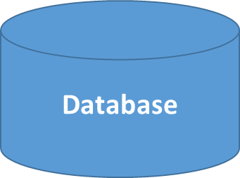
Data:
Products
User-Register
Orders
customers
users.xml
Login-password
logins.xml

Slide 4
MySQL tables:
customers: Id, username, Fiestname, Lastname, email
Products: Id, Title,Description, Price, Stock, image, Category_id
orders: Id, groupId, productID, clientId
Category: Id, Name

